Slide 1
EMPLOYEE RATING APPLICATION DATABASE DESIGN
Group 4
Mayur Mahanta
Moheth Muralidharan
Use Case Presentation
04/27/2022

Slide 2
Problem Definition
A Manufacturing Company is planning to develop a new database system which will support its new employee rating application.
The database is designed particularly to decrease biasedness and increase transparency across the company.
Employee rating is "a conscious, objective assessment of the extent to which or employee is fulfilling or exceeding the requirement of their role and in execution of the task assigned to him or her to carry any work related to activities both in absolute and comparative terms"
To address the significance of employee performance management, which is not possible without measurement. We have delivered a database system that measures the performance of all individuals and helps rate them in order to be able to manage performance growth and direction.
The rating will be done by a group of reviewers for all the employees based on their onsite performance as it is difficult to keep track of individual performance of employees solely based on attendance instead of a system where their project/work status with the efficiency they delivered with is evaluated.
The rating of an employee will be done on a pre-defined set of scores that will be utilized to determine their individual input percentage and efficiency of their work deliverance.
The final score will depend on multiple ratings and keeping in mind the transparency factor, may be/will be viewed by everyone in the company.

Slide 3
Model Requirements
There are a standard set of rules that needs to be followed for the designed model for the above specified application. They are as follows –
The employee will have one designation. Under certain conditions an employee can have more than one designation.
Every employee will belong to a department.
The employee will be rated by the group of reviewers with scores.
All work will be rated by reviewers individually.
The scores can be viewed by the employees.

Slide 4
1.
EER Diagram
This Enhanced entity-relationship (EER) diagram of the Employee Rating Application acts as helpful tools for designing and later on implementing the database. It aids in planning databases more thoroughly by delving into the properties and constraints with greater precision. We can also see the relationships between the model objects

Slide 5
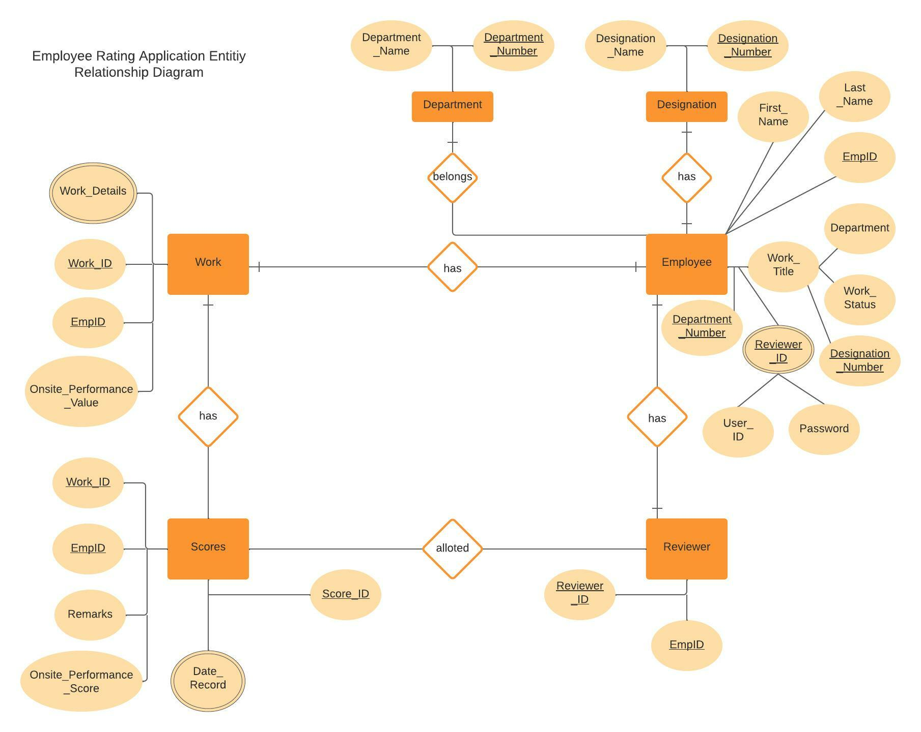

Slide 6
Design
The design constraints or the entities along with the attributes for the above Employee Rating Application System are as follows –
Employee (EmpID, First_Name, Last_Name, User_ID, Password, Designation_Name, Designation_Number, Department_Name, Department_Number, Work_Title, Work_Status, Reviewer_ID)
Designation (Designation_Name, Designation_Number)
Work (Work_ID, Work_Details, EmpID, Onsite_Performance_Value)
Department (Department_Name, Department_Number)
Scores (Score_ID, EmpID, Work_ID, Reviewer_ID, Onsite_Performance_Score, Remarks, Date_Record)
Reviewer (Reviewer_ID, EmpID)

Slide 7
UML Class Diagram
Now we will see the blueprint of the system. Referring to all the object models that will make up the Employee Rating Application System.

Slide 8
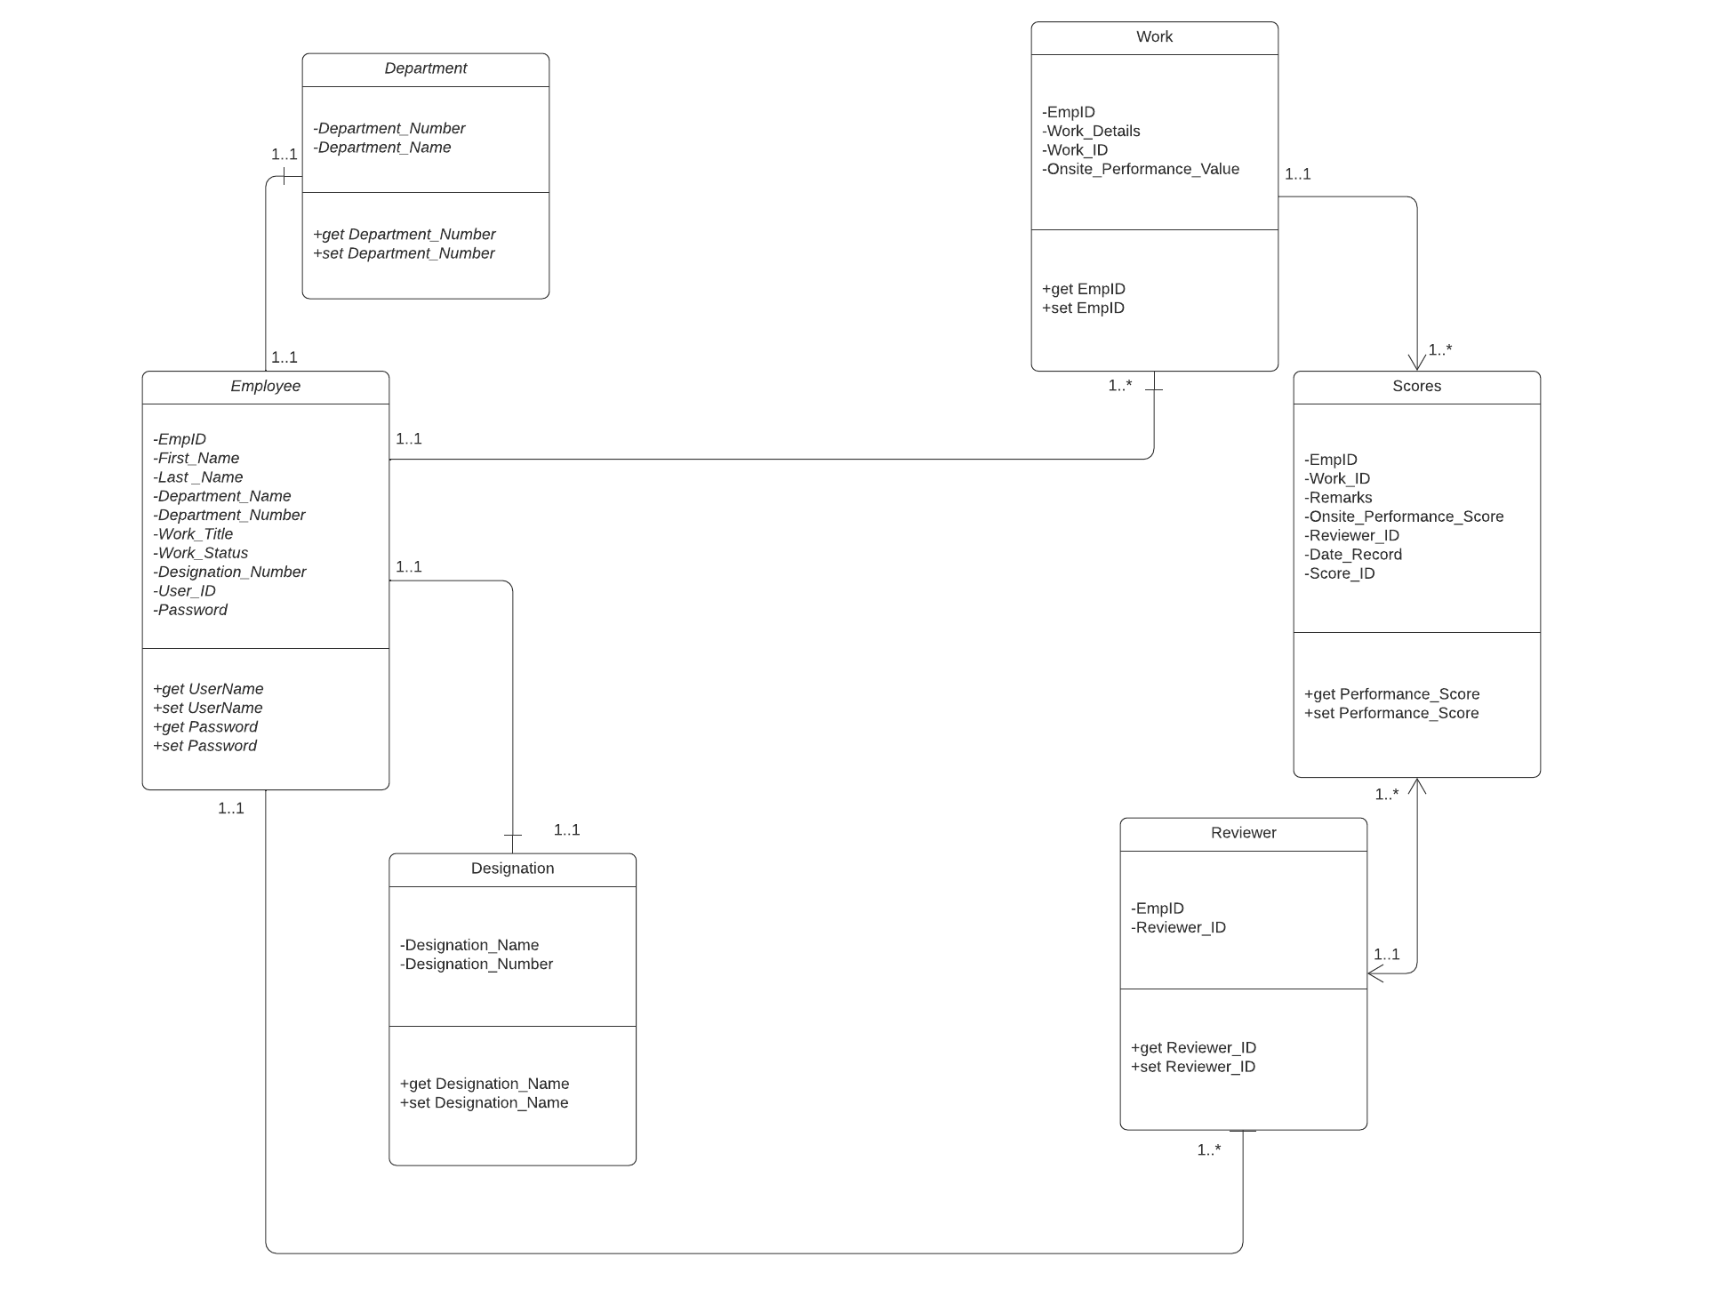

Slide 9
Relational Model
Employee (EmpID, First_Name, Last_Name, User_ID, Password, Designation_Name, Designation_Number, Department_Name, Department_Number, Work_Title, Work_Status, Reviewer_ID)
Employee: EmpID in relation to Employee: NULL not allowed, on delete/update cascade.
Designation (Designation_Name, Designation_Number)
Here, Designation_Number is the primary key.
Department (Department_Name, Department_Number)
Here, Department_Number is the primary key
Work (Work_ID, Work_Details, EmpID, Onsite_Performance_Value)
Here, Work_ID is the primary key.
Employee: EmpID in relation to Employee: NULL not allowed, on delete/update cascade.
Reviewer (Reviewer_ID, EmpID)
Here, Reviewer_ID is the primary key.
Employee: EmpID in relation to Employee: NULL not allowed, on delete/update cascade.
Scores (Score_ID, EmpID, Work_ID, Reviewer_ID, Onsite_Performance_Score, Remarks, Date_Record)
Here, Score_ID is the primary key.
Employee: EmpID in relation to Employee: NULL not allowed, on delete/update cascade.
Reviewer: Reviewer_ID in relation to Reviewer: NULL not allowed, on delete/update cascade
Work: Work_ID in relation to Work: NULL not allowed, on delete/update cascade.

Slide 10

SQL Implementation

Slide 11
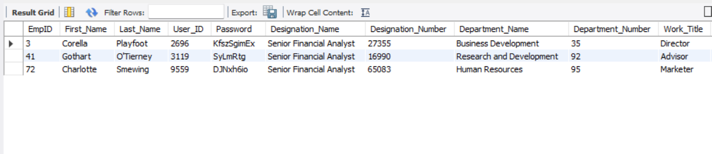
Query 1:
List of Employees with Designation as “Senior Financial Analyst”
select * from employeeratingapplication.employee
where Designation_Name="Senior Financial Analyst"

Slide 12
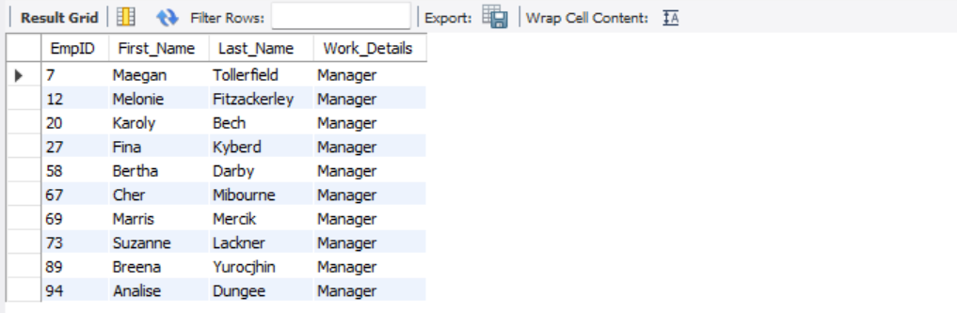
Query 2:
List Employees who are “Managers” (Aggregating)
select e.EmpID,
e.First_Name, e.Last_Name, w.Work_Details
from employee e, work w
where e.EmpID= w.EmpID
and w.Work_Details="Manager"

Slide 13
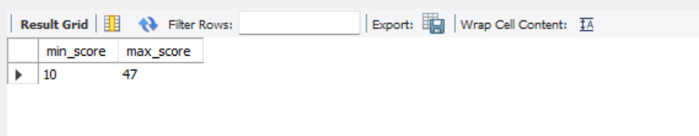
Query 3:
To find the minimum and maximum performance score of all employees (using stasticial function like min and max)
select min(Onsite_Performance_Score) as min_score, max(Onsite_Performance_Score) as max_score
from employeeratingapplication.scores

Slide 14
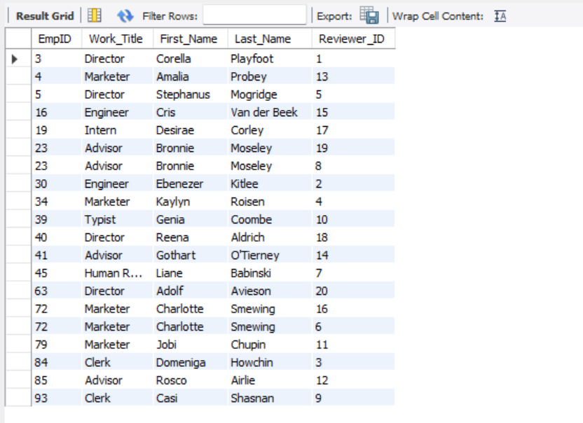
Query 4:
List of employees who are also reviewers (Aggregating)
select e.EmpID, e.Work_Title, e.First_Name, e.Last_Name, r.Reviewer_ID
from employee e, reviewer r
where e.EmpID=r.EmpID

Slide 15
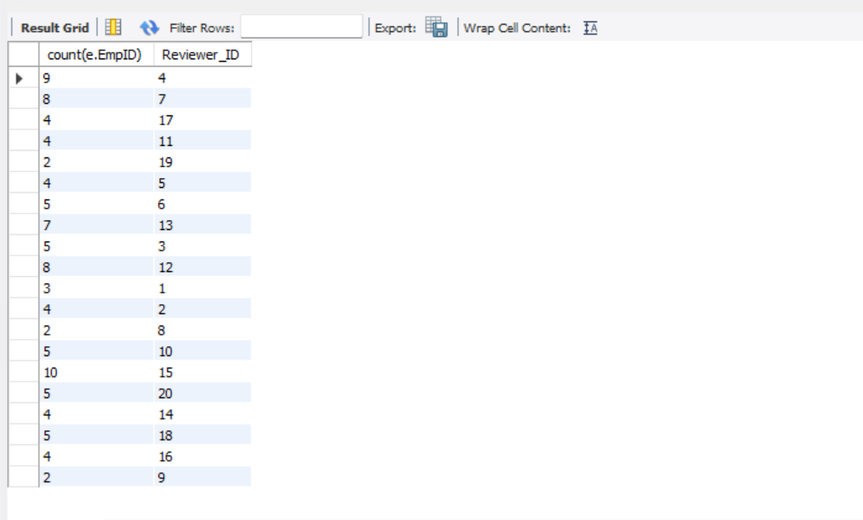
Query 5:
Number of employees assigned to each reviewer (Reviewer_ID) for reviewing using (GROUP BY Function)
select count(e.EmpID), r.Reviewer_ID
from employee e, reviewer r
where e.Reviewer_ID= r.Reviewer_ID
group by Reviewer_ID

Slide 16
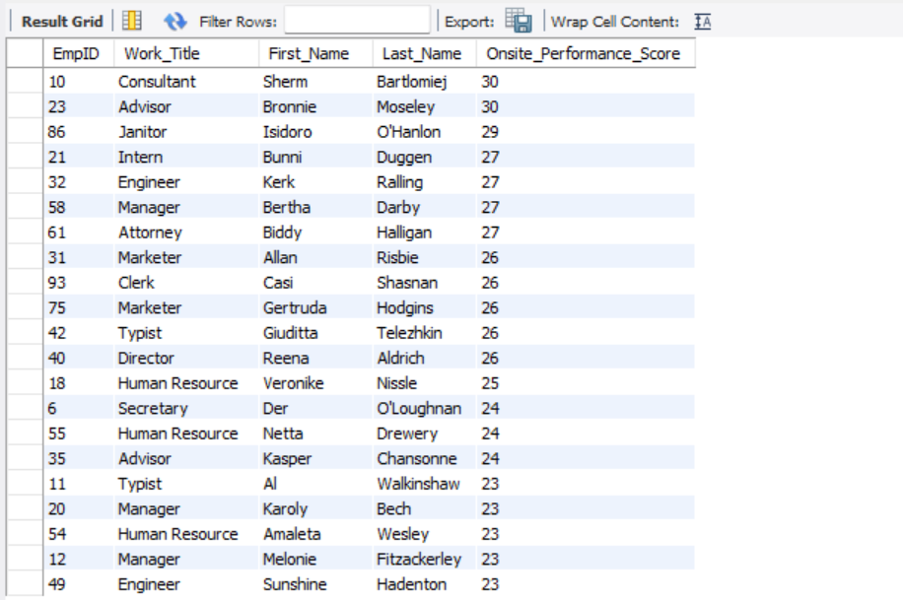
Query 6:
Listing all Employees with a performance score more than 23 (Aggregating and using ORDER BY Function)
select e.EmpID, e.Work_Title, e.First_Name, e.Last_Name, s.Onsite_Performance_Score
from employee e, scores s
where e.EmpID= s.EmpID
having Onsite_Performance_Score>=23
order by Onsite_Performance_Score desc

Slide 17
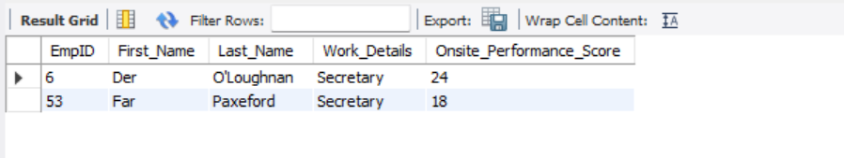
Query 7:
Listing all Employees who work as “Secretary” and has a performance score more than 15 (Aggregating based on multiple conditions)
select e.EmpID, e.First_Name,e.Last_Name,w.Work_Details, s.Onsite_Performance_Score
from employee e, work w , scores s
where e.EmpID=s.EmpID
and e.EmpID=w.EmpID
having w.Work_Details= "Secretary"
and s.Onsite_Performance_Score>15

Slide 18
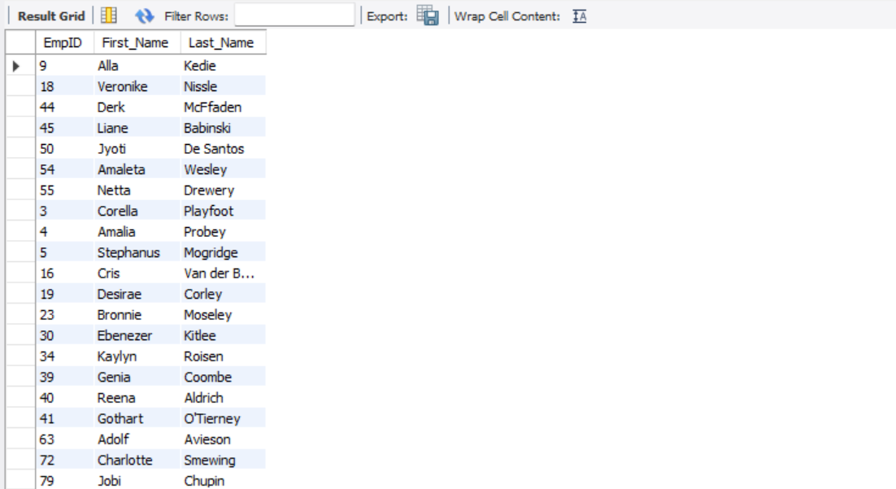
Query 8:
Listing the employees with Work_Title “Human Resource” or is a reviewer (using UNION Function)
select EmpID, First_Name, Last_Name
from employee
where Work_Title= "Human Resource"
union
select e.EmpID, e.First_Name, e.Last_Name
from employee e, reviewer r
where e.EmpID=r.EmpID

Slide 19
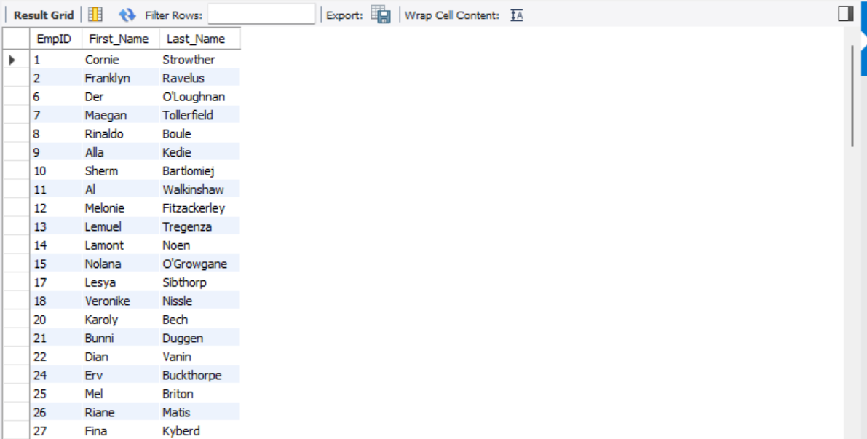
Query 9:
Listing the employees who are not reviewers (using Nested Query)
select EmpID, First_Name, Last_Name
from employee
where EmpID not in (select EmpID from reviewer)

Slide 20
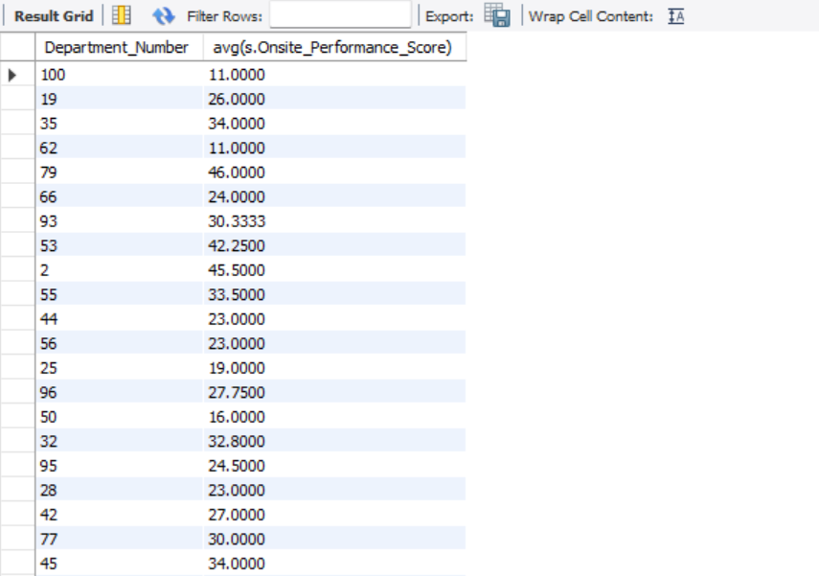
Query 10:
Finding average rating with respect to the departments (using statistical function avg using fields from two tables)
select e.Department_Number, avg(s.Onsite_Performance_Score)
from employee e, scores s
where e.EmpID=s.EmpID
group by Department_Number

Slide 21
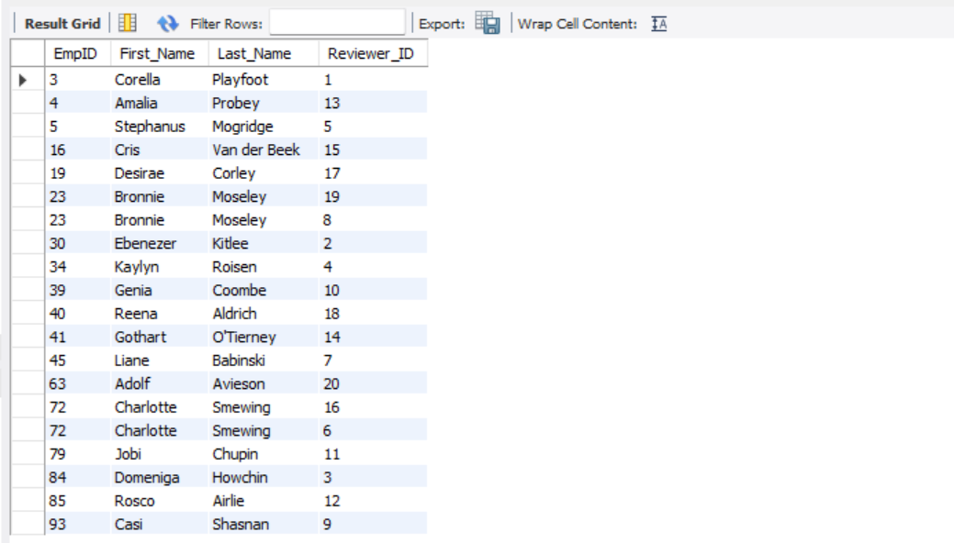
Query 11:
Listing employees names from employee table and their assigned reviewer ID’s from reviewer table using INNER JOIN
select e.EmpID, e.First_Name, e.Last_Name, r.Reviewer_ID
from employee e
inner join reviewer r
on e.EmpID=r.EmpID

Slide 22
NoSQL Implementation
Three tables –
Employee
Scores
Work
were created using Mongodb. The queries that were executed are -

Slide 23
Query 1:
List all employees who have designation “Human Resource”
>db.Employee.find({Designation_Name:"Human Resource"})
Output:

Slide 24
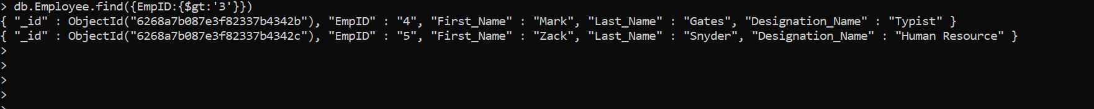
Query 2:
List all employees whose EmpID > 3
db.Employee.find({EmpID:{$gt:'3'}})
Output:

Slide 25
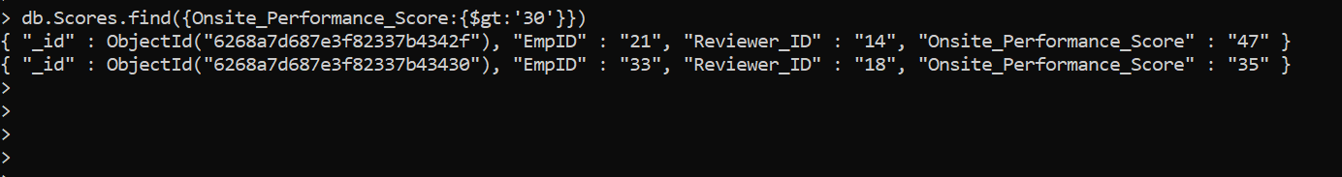
Query 3:
List all Employees who has score >30
db.Scores.find({Onsite_Performance_Score:{$gt:'30'}})
Output:

Slide 26
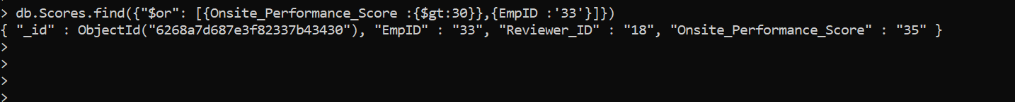
Query 4:
List all Employees who has score more than 30 or Employee who Emp ID = 33
db.Scores.find({"$or": [{Onsite_Performance_Score :{$gt:30}},{EmpID :'33'}]})
Output:

Slide 27
Database Access via python
Database is accessed using Python and analysis of the data is done via visualization and show in the following sides along with the code

Slide 28
Database connection code
import matplotlib.pyplot as plt
import mysql.connector
import pandas as pd
import numpy as np
mydb = mysql.connector.connect(host="localhost",
user="root",
password="group4",
database="employeeratingapplication")
mycursor = mydb.cursor()

Slide 29
Analysis 1
Visualizing data of the number of employees each reviewer is responsible for:
mycursor.execute('select count(e.EmpID), r.Reviewer_ID from employee e, reviewer r where e.Reviewer_ID= r.Reviewer_ID group by Reviewer_ID')
result=mycursor.fetchall
no_of_emp=[]
reviewer=[]
for i in mycursor:
no_of_emp.append(i[0])
reviewer.append(i[1])
print("Number of employees=", no_of_emp)
print("Reviewers=", reviewer)
plt.bar(reviewer,no_of_emp,color='maroon')
plt.xlabel(" Reviewers")
plt.ylabel(" Number of Employees")
plt.title("Number of Employees under each Reviewer")
plt.show()

Slide 30
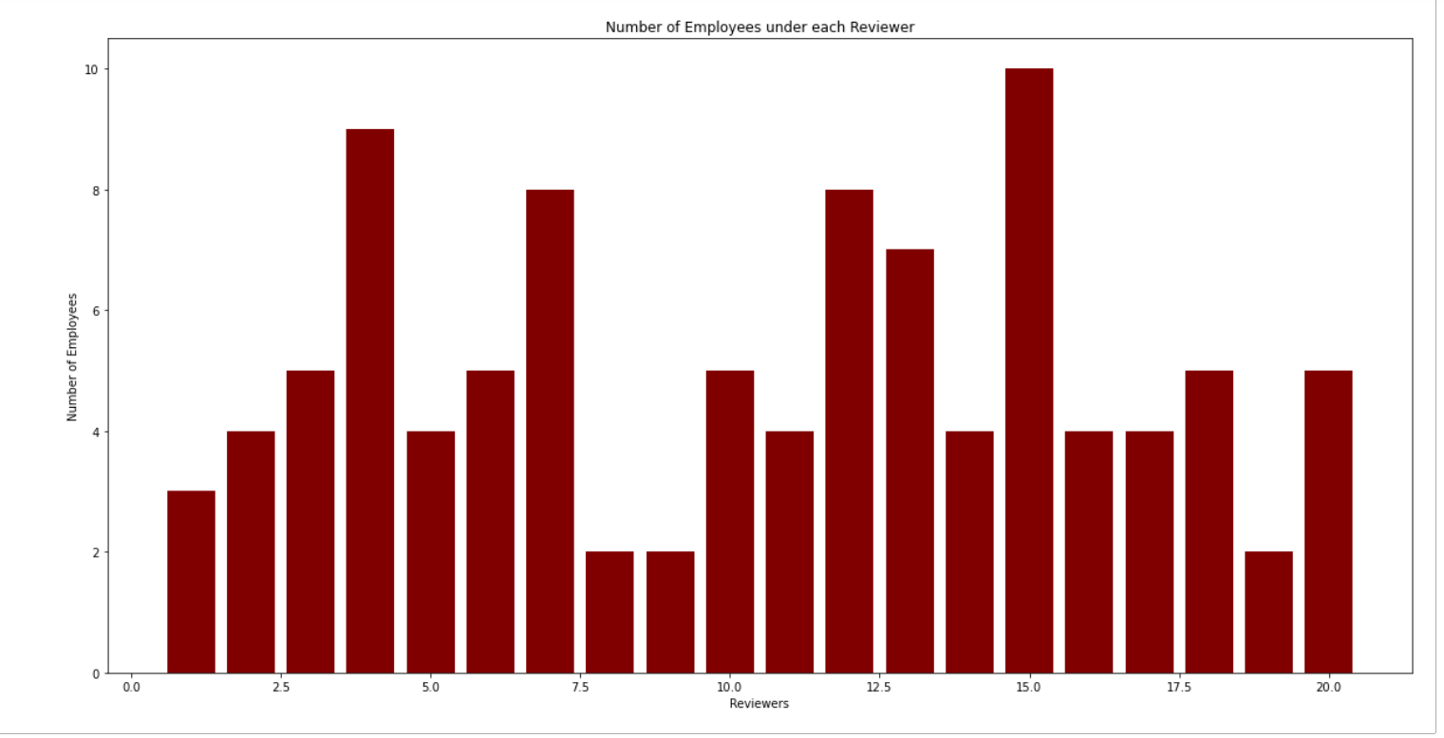
Analysis 1
Visualizing data of the number of employees each reviewer is responsible for:

Slide 31
Analysis 2
Visualizing data of the average scores each department got rewarded with:
mycursor.execute('select e.Department_Number, avg(s.Onsite_Performance_Score) from employee e, scores s where e.EmpID=s.EmpID group by Department_Number')
result=mycursor.fetchall
department=[]
department_scores=[]
for i in mycursor:
department.append(i[0])
department_scores.append(i[1])
print("Name of Department=", department1)
print("Scores=", department_scores)
plt.rcParams["figure.figsize"] = (20,10)
plt.stem(department,department_scores)
plt.ylim(10,50)
plt.xlabel("Department IDs")
plt.ylabel("Scores")
plt.title("Score of each Department")
plt.figure(figsize=(100,100))

Slide 32
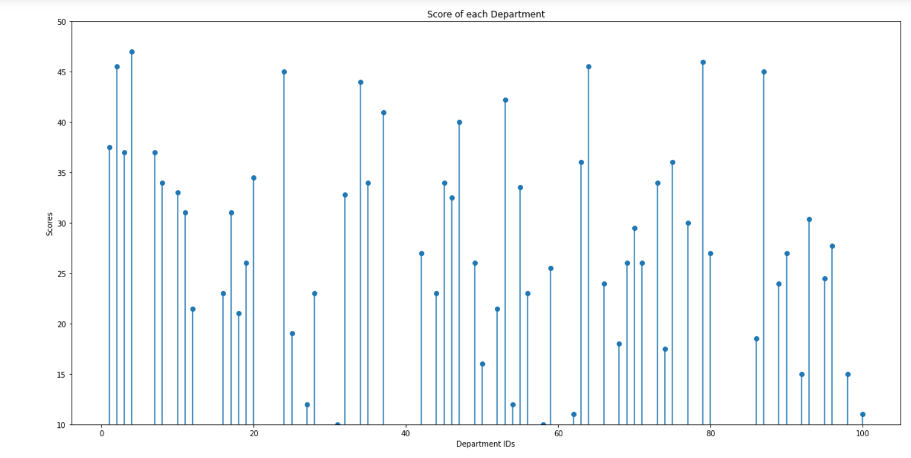
Analysis 2
Visualizing data of the average scores each department got rewarded with:

Slide 33
Analysis 3
Visualizing data of the number of scores each Work Title got
mycursor.execute('select e.EmpID, e.Work_Title, e.First_Name, e.Last_Name, s.Onsite_Performance_Score from employee e, scores s where e.EmpID= s.EmpID having Onsite_Performance_Score>=23 order by Onsite_Performance_Score desc')
result=mycursor.fetchall
work=[]
score=[]
for i in mycursor:
work.append(i[1])
score.append(i[4])
plt.scatter(work,score,color='r')
plt.xlabel("Work Title")
plt.ylabel("Performance Score")
plt.title('Scatter plot of Work Titles with the Scores')

Slide 34
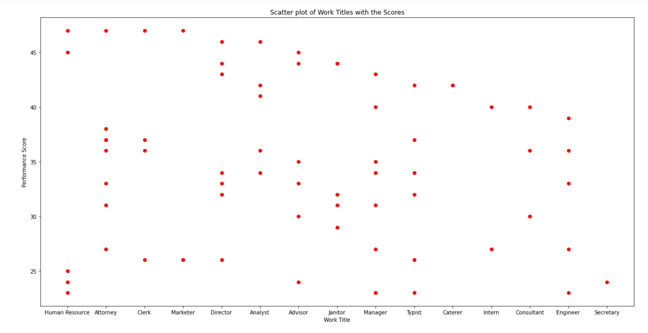
Analysis 3
Visualizing data of the number of scores each Work Title got

Slide 35
Thanks!

